Slide 1
PROJECT TITLE - ECO DRIVE
PIP2001 Capstone Project
Review-
Batch Number: CSG-G08
Roll Number | Student Name
G Nithin | 20211CSG0030
Swaroop R S | 20211CSG0034
Jayanth V | 20211CSG0012
Lohith M C | 20221LCG0003
Under the Supervision of,
Prof. Lakshmisha S Krishna
Assistant Professor
School of Computer Science & Engineering
Presidency University
Name of the Program: B.Tech Computer Science and Technology
Name of the HoD: Dr Saira Banu Atham
Name of the Program Project Coordinator: Dr Manjula H M
Name of the School Project Coordinators: Dr. Sampath A K / Dr. Abdul Khadar A / Mr. Md Ziaur Rahman

Slide 2
Introduction
Transportation is one of the largest contributors to air pollution globally, particularly in densely populated countries like India. Vehicle emissions, traffic congestion, and the over-reliance on personal vehicles have significantly increased CO2 levels and other harmful greenhouse gases (GHG), leading to worsening air quality. This poses severe environmental and health risks, such as respiratory issues and climate change.
The Eco Drive project aims to tackle this urgent problem by providing a software solution that helps individuals and communities reduce their carbon footprint through smarter, more sustainable transportation choices. The goal is to empower users to make eco-friendly travel decisions and contribute to better air quality and environmental health.

Slide 3
Literature Review
1. Carbon Footprint Calculators
Advantages: Provide detailed emissions insights, personalized recommendations.
Limitations: Lack data integration, difficult to track changes.
2. Carpooling & Ride-sharing
Advantages: Reduces vehicles and emissions.
Limitations: Focuses on long trips, lacks carbon tracking, safety concerns.
3. Public Transportation Apps
Advantages: Promotes eco-friendly transport, real-time updates.
Limitations: No carbon tracking, limited to transit info.
4. Electric Vehicles (EVs)
Advantages: Zero emissions (renewable energy-powered).
Limitations: High production impact, limited charging options.

Slide 4
Literature Review
5. Bicycle-sharing Programs
Advantages: Zero emissions, reduces congestion.
Limitations: Weather/distance dependent, area restrictions.
6. Mobile Apps for Carbon Footprint Calculation
Advantages: Feedback for better commuting habits.
Limitations: Manual input burdensome, prone to inaccuracies.
7. Community-Based Initiatives
Advantages: Foster collective action, shared responsibility.
Limitations: Relies on community participation, often inconsistent

Slide 5
Research Gaps of Existing Methods
Air Pollution in Underdeveloped Regions:
WHO reports 600% PM2.5 levels above standards in these regions.
Lack of infrastructure and localized data hinder policies.
Need scalable, low-cost solutions like mobile eco-feedback.
Gamification in Sustainability:
Limited focus on transportation and long-term behavioral impact.
Explore reward systems and cultural adaptability.
Carbon Footprint Tracking:
Static calculators lack real-time data and personalization.
Issues: manual data entry, minimal gamification, weak community features.
Solutions: integrate ML, sensors, and dynamic feedback mechanisms.
Technological & Privacy Constraints:
Data inconsistencies and limited integration with public transport.
Address privacy concerns through transparency and control.

Slide 6
Proposed Method
Overview: A comprehensive mobile app empowering users to reduce their carbon footprint through sustainable commuting choices.
Key Features:
Tracking: Utilizes smartphone sensors to track commutes and calculate carbon emissions.
Community Engagement: Allows users to join communities, compare carbon footprints
Gamification: Includes points, badges, and leaderboards to encourage eco-friendly habits.
User-Friendly Interface: Features a simple dashboard for tracking carbon savings and progress.
Architecture:
Frontend: Developed using Kotlin/Java for Android, with real-time commute tracking via GPS and sensors.
Backend: Powered by Firebase for authentication, database management, and cloud functions
Gamification System: Implements leaderboards, challenges, and rewards to incentivize eco-friendly behaviors.
Advantages:Carbon tracking, social engagement, gamification, and simple, scalable design.

Slide 7
Objectives
Carbon Footprint Tracking & Awareness: Develop a mobile app that automatically tracks and quantifies users' carbon footprint based on their daily commuting habits (modes of transportation, travel distance, and duration). This will raise awareness and address the gap in real-time carbon emission tracking seen in existing solutions.
Community Engagement & Social Competition: Implement features that allow users to form groups with family, friends, and colleagues to compete in reducing their carbon emissions. This fosters a sense of teamwork and tackles the lack of community-driven behavior change initiatives in most current methods.
Gamification for Sustainable Behavior: Introduce a gamification system where users earn virtual points, badges, and achievements based on eco-friendly habits and improvements in their carbon footprint. This adds motivation and rewards for sustainable commuting, encouraging long-term engagement.

Slide 8
Methodology
Hardware & Software Used in Eco Drive Project
Hardware:
Development System: Laptop with 8GB+ RAM (16GB recommended) and a modern processor (Intel i5/AMD Ryzen).
Mobile Devices: Android Smartphone (API Level 21+), integrated GPS for location tracking.
Internet Connection: Reliable connection for server-side deployment, API access, and real-time data sync.
Software:
Mobile App Development: Android Studio (IDE), Kotlin/Java for coding.
Backend Development: Python-based APIs hosted on a cloud platform, MySQL for secure data storage.
APIs & Services: Google Maps API for route tracking, Firebase Cloud Messaging (FCM) for notifications.
Version Control & Collaboration: Git (GitHub/GitLab) for version control and team collaboration.
Testing Tools: Android Emulator for device testing, Postman for API testing.
Deployment & Cloud Hosting: Heroku/Railway for backend hosting, Firebase Hosting for static content.

Slide 9
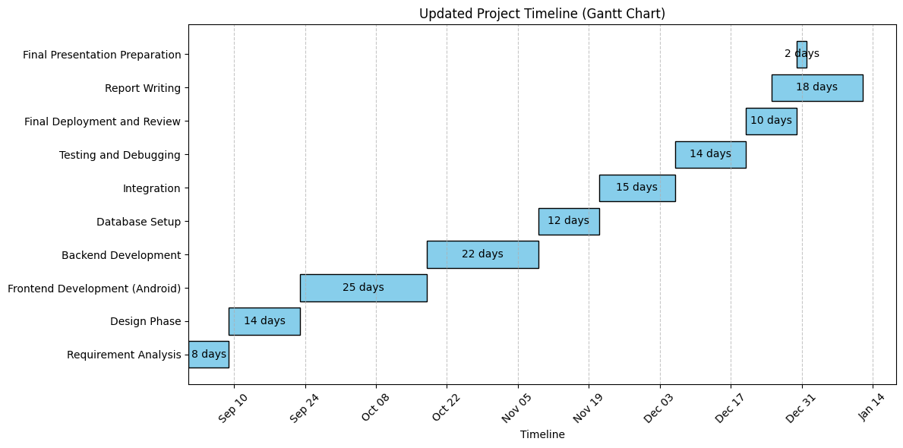
Timeline of Project

Slide 10
Expected Outcomes
Increased Awareness: Real-time carbon footprint tracking fosters eco-conscious travel decisions.
Community Engagement: Virtual communities encourage collaboration, competition, and collective emission reduction efforts.
Sustainable Behavior Change: Gamification elements drive adoption of greener commuting habits, reducing transportation emissions.
Data-Driven Insights: Collects and analyzes commuting patterns, enabling future sustainability initiatives.
Enhanced User Experience: Intuitive interface and engaging features ensure higher adoption and long-term usage.
Scalable Model: Supports future expansions with features like route optimization and electric vehicle integration.

Slide 11
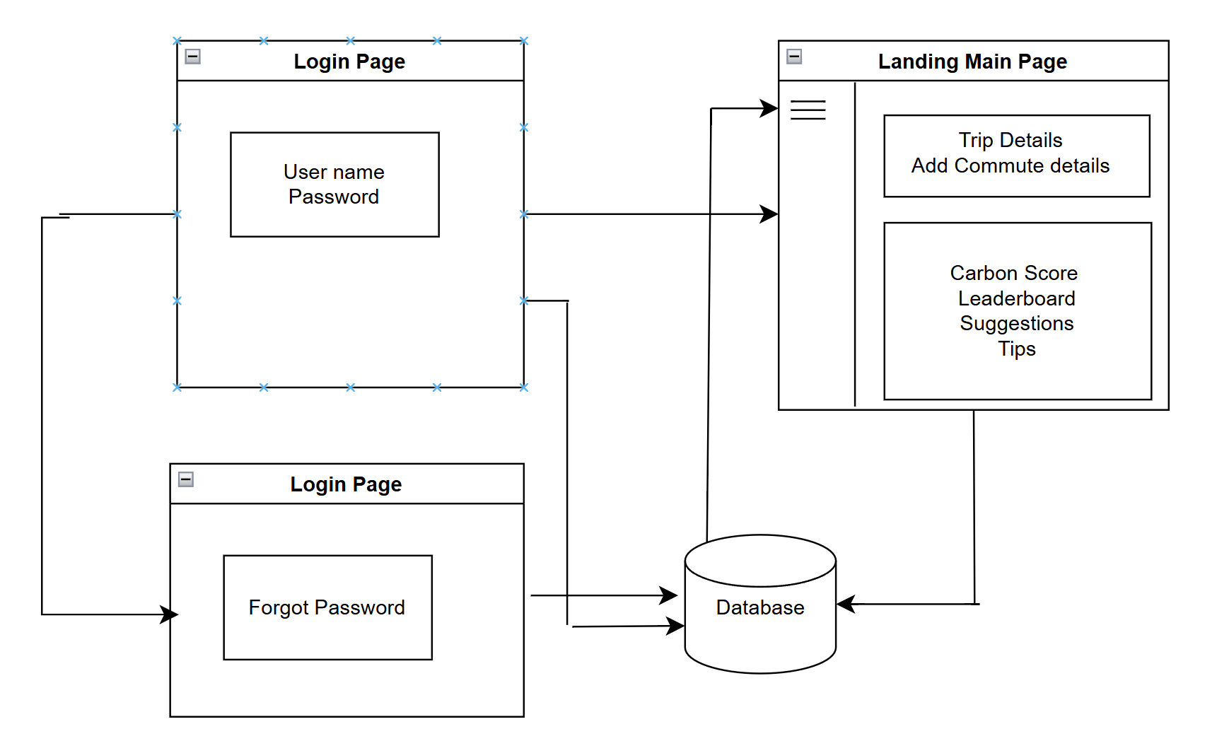
Front end Architecture

Slide 12
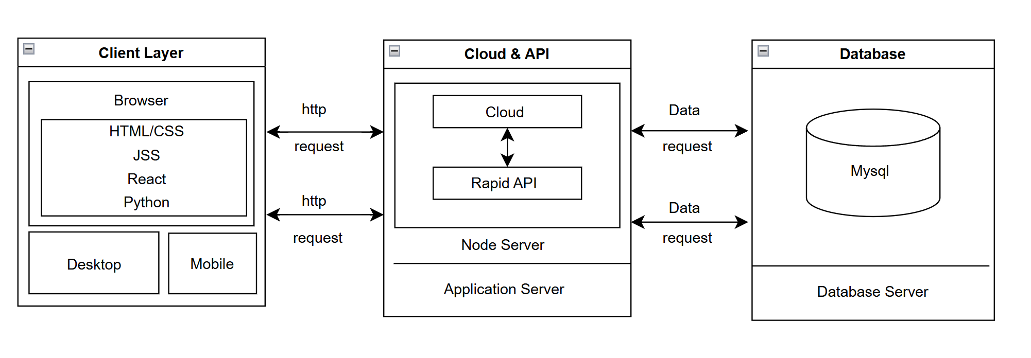
Back end Architecture

Slide 13
Conclusion
Eco Drive has achieved its goal of promoting sustainable transportation and reducing carbon footprints through a combination of innovative features and user-centric design. By fostering environmental awareness, encouraging behaviour change, and leveraging technology for meaningful impact, the project has contributed to a greener, more sustainable future. Its success demonstrates the power of technology in addressing global challenges and highlights the importance of individual and collective action in creating a positive environmental legacy.

Slide 14
Problem Statement
Organization: An organization focused on leveraging technology and innovation for carbon footprint reduction through sustainable transportation, gamification, and community engagement. It emphasizes data-driven solutions and user-friendly applications to address environmental challenges.
Category (Hardware / Software / Both): Software – The primary focus is on software-based solutions, such as mobile applications integrating GPS, accelerometer data, machine learning algorithms, and gamification techniques.
Problem Description: The organization aims to tackle the environmental challenges posed by increasing carbon emissions, particularly from transportation, urbanization, and industrial activities. The lack of real-time, user-friendly tools for tracking and reducing carbon footprints, combined with limited community engagement and user motivation, exacerbates the problem.
Difficulty Level:
Moderate to High – While software development for carbon tracking and gamification is technically feasible, challenges include:
Sustaining user engagement through gamification and community dynamics.
Addressing privacy concerns and ensuring secure data handling.
Scaling solutions for diverse user bases with varying cultural and technological backgrounds.

Slide 15
Github Link

Slide 16
References
United Nations Environment Programme (UNEP). (2021). Global Environment Outlook 6: Healthy Planet, Healthy People. Retrieved from unep.org
World Health Organization (WHO). (2021). Air Quality and Health. Retrieved from who.int
International Energy Agency (IEA). (2022). Global EV Outlook 2022: Securing supplies for an electric future. Retrieved from iea.org
Khan, A. S., & Kham, K. M. (2020). Smart mobility solutions and sustainable transport: A review. Journal of Cleaner Production, 248, 119-134.
Green, D. R., & Sun, L. (2019). The Role of Gamification in Environmental Awareness: A Case Study of Carbon Footprint Applications. Sustainability, 11(16), 4572.
Google Developers. (2022). Maps SDK for Android. Retrieved from developers.google.com
Firebase. (2022). Firebase Documentation. Retrieved from firebase.google.com

Slide 17


